Slide 1
MassHealth Provider Portal
A How To Guide for Using Your Online Resource

Slide 2
TABLE OF CONTENTS
Select a link below to view the instructions
Register ……………………………………………………………………………………………. 4
Logging In ……………………………………………………………………………………………………………………..7 Resetting Your Password ……………………………………………………………………………………………………..8
Home ………………………………………………………………………………………….……. 9
My Account ……………………………………………………………………………………………………………………10 Notification Center …………………………………………………………………………………………………………… 11
Provider Administration …………………………………………………………….…….12
Add Users …………………………………………………………………………………………………………………….. 12 Manage Users ………………………………………………………………………………………………………………. 14 Search Users …………………………………………………………………………………………………………………. 14 Create Billed Amount List ……………………………………………………………………………………………… 15 Billed Amount Associations …………………………………………………………………………………………… 18 Assign Billed Amount List ………………………………………………………………………………………………… 18
Dental Information ………..……………………………………………………………….. 19
Search Affiliated Providers ………………………………………………………………………………………………..19
Patient Management …………………………………………………………………...... 21
Member Eligibility …………………………………………………………………………………………………………21 Member Detail ……………………………………………………………………………………………………………… 23 Search Broken Appointments ……………………………………………………………………………………….. 27 Submit Broken Appointments …………………………………………………………………………………………..28
Claims/Prior Authorizations ….………….……………………………………………. 29
Search Claims/Prior Authorizations …………………………………………………………………………………. 29 Void Claims ………………………………………………………………………………………………………………………. 30 Submit Claims/Prior Authorizations …………………………………………………………………………………. 32 Claims Confirmation Report …………………………………………………………………………………………..... 34
2

Slide 3
TABLE OF CONTENTS
Select a link below to view the instructions
Remittance …...……………………………………………………………………………... 35 Document List ……………………………………………………………….………………. 36 Find a Dentist ..………………………………………………………………………………. 37 Contact Us …………………..………………………………………………….…………..... 38
Submit Inquiry ……………………………………………………………………………………………………………….. 39 Review Inquiry ……………………………………………………………………………………………………………….. 41
Download Reports ……………………………………………………………………….…43 MassHealth Contacts ……………………………………………………………………….44
3

Slide 4
HOW TO
Register for the Portal
STEP 1
The only way to self-register for the Portal is as a Super User. In order to do this, you will need to have information about both the business office and specific details on at least one of the Providers at that office. Key information that you will need in order to self-register include the Provider’s first and last name, NPI and license number, as well as the tax ID for the practice without any dashes.
If you are a designated Super User for the practice and have this information available, go to
https://provider.masshealth-dental.net/ and click REGISTER.
Tip: A Super User is someone in your practice who has complete administrative privileges across your organization, including access to all employee and patient records. It is recommend that you restrict the number of Super Users to a minimum.
Tip: If you are unsure whether you are a designated Super User for your practice and/or not sure if you have all of the necessary information to self-register, please contact your MassHealth representative.

Slide 5
HOW TO
Register for the Portal
STEP 2
Complete all of the required information on the registration
page and click REGISTER.
If all of the information is correct, you will receive a “Registration Successful” notification. You will then have Tier 1, or Super User, access, which can be used to add all further users in the system.
If your registration is not successful, try the following:
Tip: Always use a business email address, not a personal email, when registering on the Portal.
Adjust the Provider Name if the provider name is Bob M Smith try both “Bob Smith” or “Bob M Smith” in the Provider Name field
Enter information ID#’s without dashes and spaces
IDs must match exactly: The License (i.e DN0000), NPI and Tax ID entries must match what is on file.
If your registration is still unsuccessful, please contact your MassHealth representative.

Slide 6
HOW TO
Register for the Portal
STEP 3
If your registration was successful, you will receive an email with directions for logging into the Portal. Click the link, and verify that your information is correct. You will only need to go through the registration process once.
STEP 4
Update your temporary password to a permanent password. You can set your security questions and answers.
Tip: All three security questions must have different answers. You may want to write down your password and security questions and answers, and file the information in a safe place.
STEP 5
It is recommended that you add at least one other Super User right away. Note that adding other Super Users (or standard users) does not require the self-registration process. They can be added through the simple Manage Users section of the Portal.

Slide 7
HOW TO
Login to the Portal
STEP 1
In your browser, go to https://provider.masshealth-dental.net/ and click SIGN IN.
STEP 2
Enter the email address used to register, or that was used by your Administrator to create your login. Enter the password and click Login.

Slide 8
HOW TO
Reset a Password
STEP 1
If you’ve forgotten your password, go to the Sign In page (https://provider.masshealth-dental.net/) and click SIGN IN.
STEP 2
Click the “Forgot password?” link right above the
Login button.
STEP 3
On the next page, in the User ID field, enter the email used to register for the Portal and click OK.
STEP 4
You will receive an email. Open the email, click the link, and update your password as directed. When done, click Submit. If you don’t see the email, be sure to check your spam folder.

Slide 9
HOW TO
Navigate the Home Page
Home Page
Click the Mass.Gov link to visit the MassGov website
Click Home to return to this page at any time
The navigation menu runs across the top of the page
See page 12 for information on adding and managing users of this Portal
See page 28 for information on searching, submitting and voiding Claims and Prior Authorizations
See page 42 for information on Reports
Tip: Not all users will see all icons. Users will only see those icons for which they have permission.

Slide 10
HOW TO
Update My Account
STEP 1
Click My Account on the top navigation menu.
STEP 2
Type the updated name and/or EOB notification preference, then click UPDATE INFORMATION. Click UPDATE PASSWORD or UPDATE USER PROFILE to update either of those items.

Slide 11
HOW TO
Access the Notification Center
STEP 1
Click the bell icon in the top right corner to see a glimpse of any messages. Click VIEW NOTIFICATIONS to see all notifications in their entirety.
STEP 2
Any notifications will display in the message list. Click View All New to see new notifications or View
All Previous to see older notifications.

Slide 12
HOW TO
Add a New User
STEP 1
Clicking the Manage Users icon on the home page will take you to the same page as selecting Provider Administration > Manage Users on the navigation menu. Only Tier 1 users (Super Users) will be able to manage users.
STEP 2
Before adding a new user, you may want to check to see if they are already registered on your account. Enter the person’s Last Name, then click SEARCH.
STEP 3
The search results will display a list of users matching the search criteria. If the desired user is not found, click ADD NEW USER.

Slide 13
HOW TO
Add a New User
STEP 4
Enter the user’s First and Last Name, and Unique Email address. Follow the instructions to set the user’s Tier, Role and Permissions. When done, click ADD USER.
Tip: Tier 1 users (Super Users) default to having all of the permissions enabled.
STEP 5
Once the user has been successfully added, you will receive a confirmation message.

Slide 14
HOW TO
Manage / Edit Users
STEP 1
From the Manage Users page, you can update user information. To search for a specific user, enter their last name or email and click SEARCH. Or, to view a list of all users, leave the fields blank, then click SEARCH. Click on the name of the user you wish to edit.
STEP 2
This will bring up the Edit User page, where you can update the user’s name, tier, role, email address, location and permission levels, as well as lock or disable the account. When complete, click UPDATE USER.
Tip: Once a user has been added, they can never be permanently deleted, only disabled or enabled. If a user no longer needs access to your account, either temporarily or permanently, set the Disabled field to Yes. To re-enable them, set the field to No.

Slide 15
HOW TO
Create a Billed Amount List
STEP 1
Provider offices have the ability to store billed amounts by procedure codes. This will result in faster and easier online claim submission. To get started, select Provider Administration > Amount List from the navigation menu.
To create a new Billed Amount List, click the ADD button.
STEP 2
In the popup screen, name the new Billed Amount List, then click CREATE.
STEP 3
The Results listing will populate with the new Billed Amount List. Before the list can be used, it is necessary to associate the list with providers and service offices, and add procedure codes.
Click the name to open the Billed Amount Detail page.

Slide 16
HOW TO
Create a Billed Amount List
STEP 4
To associate the Billed Amount List to a service office or provider, click ADD BILLED AMOUNT ASSOCIATION.
STEP 5
In the popup screen, select a Service Office from the drop down list, then search for a Provider connected to that office. Click ADD.
STEP 6
The Billed Amount List Associations result list will populate with the new Service Office and Provider selections. Continue adding associations by clicking ADD BILLED AMOUNT ASSOCIATION and following the same steps.
You can remove associations by clicking UNLINK.
Tip: Billed Amount List Associations are specific to particular combinations of Service Offices and Providers. To make a list available to multiple offices and providers, the list will need to be associated with each Service Office / Provider combination separately.

Slide 17
HOW TO
Create a Billed Amount List
STEP 7
Next, add procedure codes. Click ADD BILLED AMOUNT DETAIL.
STEP 8
In the popup screen, enter a Procedure Code and Billed Amount. The Procedure Code Description will auto populate. Click ADD.
STEP 9
The Billed Amount List Detail result list will populate with the new procedure. Continue adding procedures by clicking ADD BILLED AMOUNT DETAIL and following the same steps.
You can edit or delete procedures by clicking EDIT or DELETE as necessary. Click PRINT THIS PAGE to print a copy for your records.

Slide 18
HOW TO
Assign Billed Amount Lists
STEP 1
You can assign or edit Billed Amount Lists by selecting Provider Administration > Billed Amount Association from the navigation menu.
STEP 2
By leaving all fields blank and hitting SEARCH from the Billed Amount Association page, you will be able to see a list of all Billed Amount List Associations that have been created.
STEP 3
To disassociate a List from an office or dentist, click UNLINK for that List.

Slide 19
HOW TO
Use the Dentist List
STEP 1
The Dentist List tool is for checking the credentialing and contact information for offices and dentists specific to this login, based on the Tax ID number. Select Provider Administration > Dentist List from the navigation menu.
STEP 2
To search for a specific office or dentist, enter as much information as possible in the search fields. To search for all associated offices and dentists, leave the search fields blank and click on SEARCH.
STEP 3
You can print or download the search results. To view additional details, click the links under Name
or Treating Dentist.

Slide 20
HOW TO
Use the Dentist List
STEP 4
Review additional details about affiliated providers, including License information, Network Affiliations and Service Offices.
If any information needs to be updated, use the Contact Us form to submit updated details. Click
Contact Us on the top navigation bar to open the form.

Slide 21
HOW TO
Check Member Eligibility
STEP 1
You can quickly check coverage eligibility of members. Click Patient Management > Member Eligibility from the navigation menu. In the form, enter a Provider and Location, the Member’s Service Date (date on which they received treatment), Date of Birth, and either Member ID or Member Last Name.
STEP 2
Repeat the above step on this same page to search eligibility for multiple Members at the same
time. If more search lines are needed, click “+ ADD ADDITIONAL SEARCH LINES”. When all Members are entered, click on the SEARCH button. You can search for up to 30 members at a time.

Slide 22
HOW TO
Check Member Eligibility
STEP 3
Search results will return in three sections: Active, Ineligible, and Not Found.
Tip: The Benefit Effective Date for members will display in the eligibility Search Results.
If a Member is not found based on your search information, this could mean that they are not
in the system, incorrect data was entered, or that there is more than one Member with matching information (such as matching Service Date, Date of Birth, and Last Name). You can SEARCH AGAIN and add more information, such as First Name or Member Number.
STEP 4
It is possible to save the search list for later use, as Proof of Eligibility for all appointments scheduled on the date of service with time and date stamp. Simply click on SAVE SEARCH.
Saved searches will display at the bottom of the Member Eligibility page. Click LOAD SEARCH to re-populate the search fields with all previously entered data. You will need to re-select the Location and Provider field manually.

Slide 23
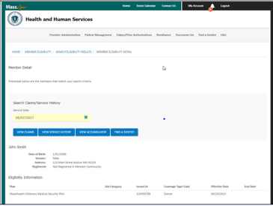
HOW TO
Check the Member Detail Page
STEP 1
From the Member Eligibility Search Results page, click on the Member Number.
STEP 2
Clicking on the Member Number will open Member Eligibility Detail page in which you can also print and save as Proof of Eligibility on the date of service. . This page provides information regarding the member, including contact information, claims, service history and more.
Tip: The Benefit Effective Date for members will display in the Member Detail page.

Slide 24
HOW TO
Check the Member Detail Page
STEP 3
Click VIEW CLAIMS to review claim information for this member. The page will automatically load the member’s information. To modify your search, enter the relevant information then click SEARCH.

Slide 25
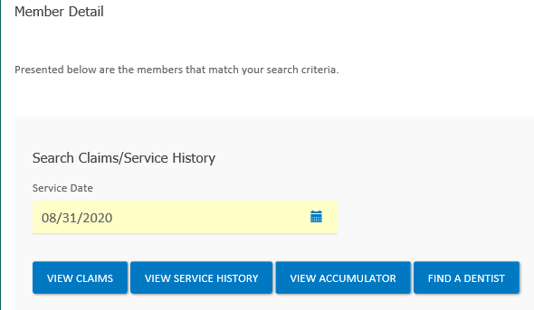
HOW TO
Check the Member Detail Page
STEP 4
From the Member Detail page, you can also review the member’s Service History. Click VIEW SERVICE HISTORY.
STEP 5
Review the results of the Service History search.

Slide 26
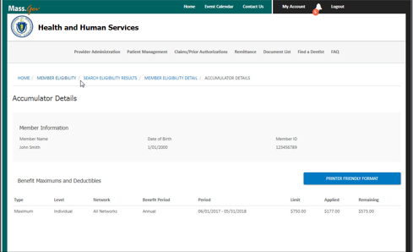
HOW TO
Check the Member Detail Page
STEP 7
From the Member Detail page, you can also check a CMSP members fiscal year balance. Click VIEW ACCUMULATOR.
STEP 8
Review the results of the Service History search.

Slide 27
HOW TO
Search Broken Appointments
STEP 1
You can search for broken appointments for your office. Select Patient Management > Broken Appointments from the navigation menu. Enter the relevant information and click Search.
STEP 2
Search results will display a list of broken appointments.

Slide 28
HOW TO
Submit Broken Appointments
STEP 1
You can submit broken appointments for your office. Select Patient Management > Broken Appointments from the navigation menu. Enter the patient type, category of service, reason for the broken appointment and language spoken by the patient, as well as any notes, then click SUBMIT BROKEN APPOINTMENT.
STEP 2
Once the broken appointment is submitted, you will receive a confirmation.

Slide 29
HOW TO
Search Claims/Prior Authorizations
STEP 1
Clicking on the Claims/Prior Authorizations button from the Home page or the link from the navigation menu will bring you to the Search Claims and Prior Authorizations page.
Enter the relevant information and click Search. Alternatively, simply choose either Dental Claim or Prior Authorization and click SEARCH to see all results for either category.
STEP 2
Search results will display information about the Claim or Prior Authorization, including the date received and the amount paid. To view more details, or to Void a Claim, click on the appropriate listing under Claim/Prior Auth Number.

Slide 30
HOW TO
Request a Claim be Voided
STEP 1
To void a Claim, first Search for the Claim using the process described previously, and click on the Claim/Prior Auth Number to display Claim details. From the Claim details page, click VOID CLAIM.

Slide 31
HOW TO
Request a Claim be Voided
STEP 2
On the Void Request Form, enter the required information, including the total amount of the service(s) to be voided, provider information from page 1 of a remit, and a reason for the void. You must attach supporting documentation of the service(s) from a remittance or from the claim detail page and circle the service lines that need to be voided to ensure the correct services are voided. Once completed click SUBMIT VOID CLAIM.
STEP 3
Once the void is submitted, you will receive quick confirmation with green check mark. After the successfully submitted the curser will just spin. No other action is needed.

Slide 32
HOW TO
Submit Claims/Prior Authorizations
STEP 1
To submit a Claim or Prior Authorization, select Claims/Prior Authorizations > Submit Claims & Prior Authorizations from the navigation menu. Enter the relevant information and click SEARCH. This will confirm the Member’s eligibility.
STEP 2
The Optional Information section mirrors standard language on the ADA claim form. These fields are not required, but are present for those providers that want to include the additional detail.
Tip: The Initial Deductible fields Deductible Anniversary Date and Deductible Percentage Met are for Health Safety Net providers only.

Slide 33
HOW TO
Submit Claims/Prior Authorizations
STEP 3
After entering all basic information about the claim and determining Member eligibility, add individual line items to your claim. This is done by entering Procedure Codes that were created as Billed Amount Lists, as well additional information about the tooth or teeth serviced.
You can also attach supporting documents directly to the Claim.
STEP 4
Once the Claim is submitted, you will receive a confirmation and the Claim Number.

Slide 34
HOW TO
View a Claims Confirmation Report
STEP 1
As an administrative function, some Providers like to print out copies of submitted claims to place in patients’ files.
To obtain a Dental Claim Confirmation Report, select Claims/Prior Authorizations > Claims Confirmation Report from the navigation menu. Enter the Service Office, Treating Dentist, and what type of submission was made. The report can be sorted either by Member ID or Member Last Name. Click PRINT THIS PAGE to print the report.

Slide 35
HOW TO
Search Remittance
STEP 1
You are able to look up past payments using the check or deposit number, Payer Name, Payee Name, or you can opt to see all payments for a given date range. The last eighteen months worth of records will be available. Select Remittance on the navigation menu.
STEP 2
Enter the data you want to search on. The last eighteen months worth of records will be available. Click SEARCH when complete.
STEP 3
Review payment details. To view additional payments, click VIEW MORE.

Slide 36
HOW TO
View your Document List
STEP 1
Your Document List contains items that have been attached for your reference. Select Document List on the navigation menu.
Leave all fields blank and click SEARCH to see a list of all documents. Alternatively, add more information to the search fields to narrow your results, such as searching by category of document.
STEP 2
Search results display the title of the document, the date it was uploaded, category of document, and a brief description. Click DOWNLOAD to download the document and read it.

Slide 37
HOW TO
Find a Dentist
STEP 1
Select Find a Dentist on the navigation menu. You can search either by Plan or by Member.
STEP 2
Enter further search criteria, including Zip Code and search radius. Additional search details to narrow the results are optional.

Slide 38
HOW TO
Contact Us
STEP 1
Select Contact Us from the top navigation menu. The page lists the phone number and mailing address for Customer Service.

Slide 39
HOW TO
Submit an Inquiry
STEP 1
Select Contact Us from the top navigation menu. Click the Submit an Inquiry link.
STEP 2
Indicate whether your inquiry concerns a disagreement with a decision made about a Denial of Service or Payment of a Claim.

Slide 40
HOW TO
Submit an Inquiry
STEP 3
If your reason for inquiry is to disagree with a Denial of Service or Payment of a Claim, select the appropriate information type, enter the Claim or Authorization number and click SUBMIT.
STEP 4
Alternatively, if you are submitting a Complaint or General Inquiry, select “NO” you don’t disagree with a denial. Fill in as much detail as possible regarding the issue and your desired outcome. You can also upload supporting documentation by clicking ADD FILE. When complete, click SUBMIT.

Slide 41
HOW TO
Review an Inquiry
STEP 1
Select Contact Us from the top navigation menu. Click the Inquiry Management link.
STEP 2
Click an Inquiry Number to review details of that inquiry.

Slide 42
HOW TO
Review an Inquiry
STEP 3
Review the Inquiry Details. To add comments, enter them in the comment field, then click
SHARE.
STEP 4
You can upload supporting documentation by clicking ADD FILE and ATTACH FILE.

Slide 43
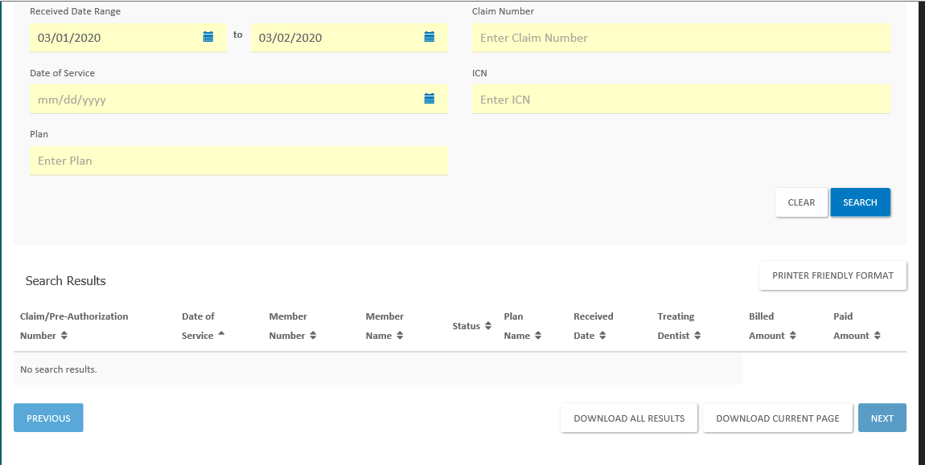
HOW TO
Download Reports
STEP 1
You can download reports under “Search claims & authorizations”. Enter a date range and click “search”. Click the “Download All Results tab at the bottom of the page.
STEP 2
Enter a date range or leave blank to search all reports. Click SEARCH. If reports are available, they
will display in the list. Click the DOWNLOAD link(s) to download desired reports.

Slide 44
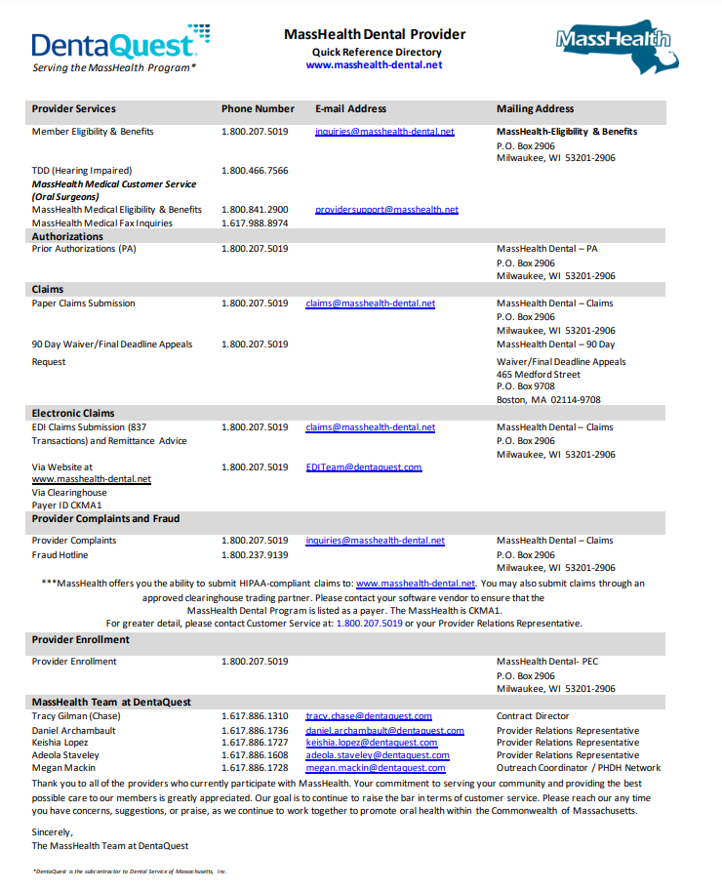
MassHealth Provider Portal
User Guide
Contacts

